Slide 1
Unit 6 Let's go shopping!

Slide 2
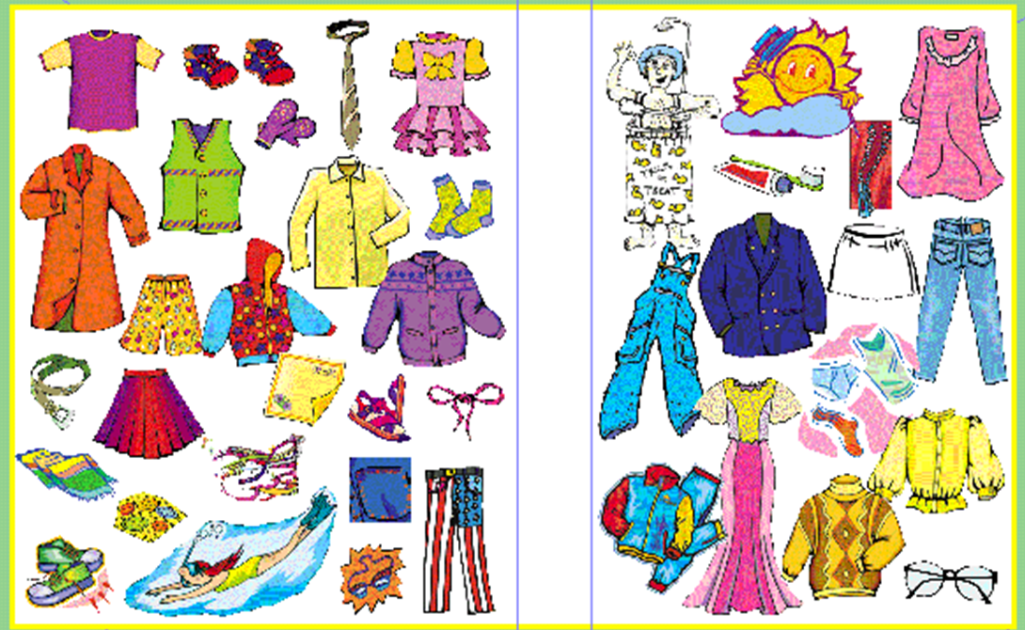

Slide 3
Chant
I likes socks.
I don’t likes shirt.
I likes dress.
They like it all.

Slide 4
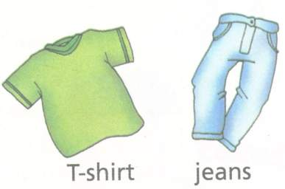
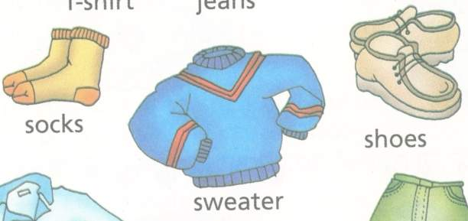
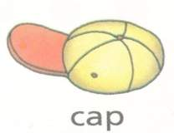
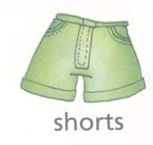

Slide 5
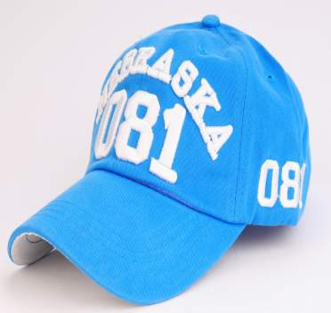
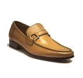
a blue cap
brown shoes

Slide 6
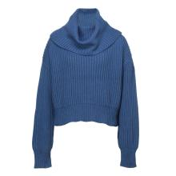
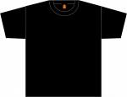
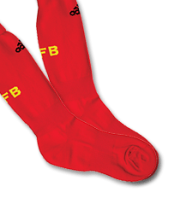
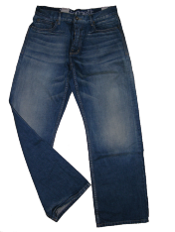
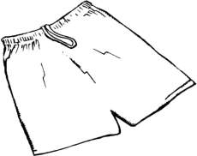
a black T-shirt
a blue sweater
red socks
white shorts
blue jeans

Slide 7
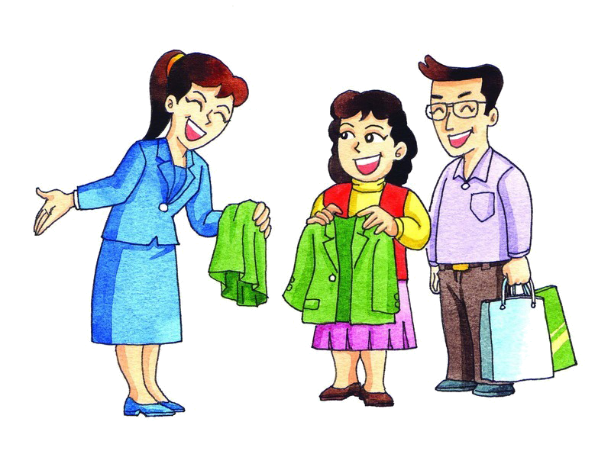
How about the green coat?
Yes, I like it
very much.

Slide 8

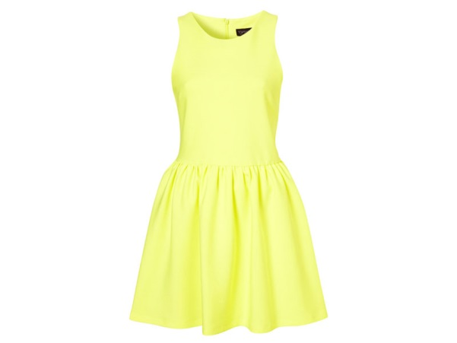
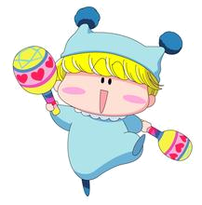
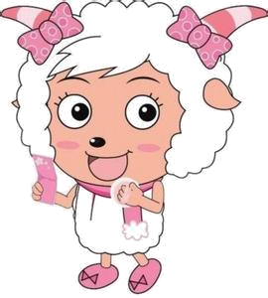
Look at my dress. It’s yellow dress.
I like the yellow dress.

Slide 9
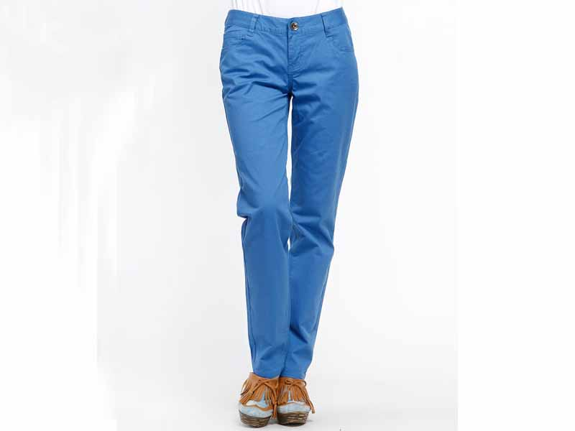
Look at my pants. It’s blue pants.
I like the blue pants.

Slide 10
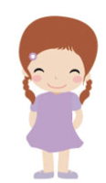
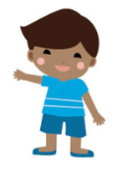
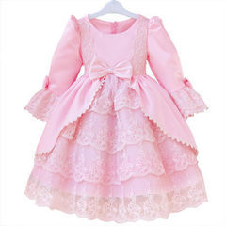
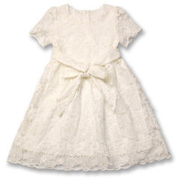
Let’s do
I like the pink dress.
How about you?
I like the white one.
dress

Slide 11
Let’s play a game!
Look at the picture and
describe
what they are wearing.

Slide 12
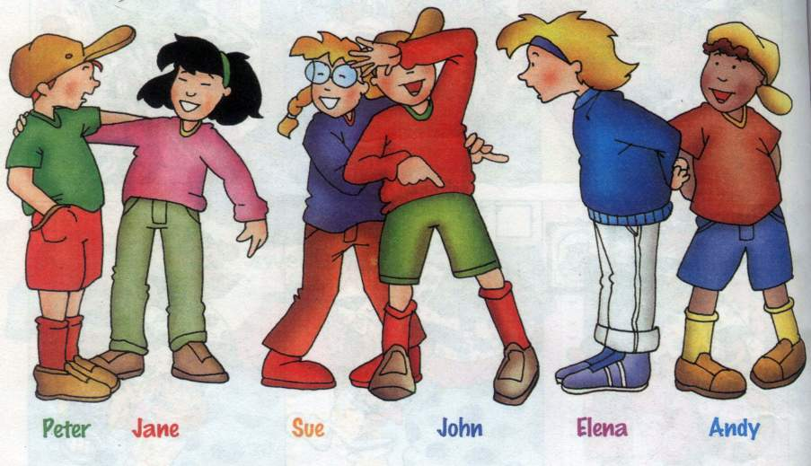
1
Andy
2
Elena
3
Peter
4
Sue

Slide 13

Homework:
Describe your parents’ clothes.

Slide 14
Thank you!

